Slide 1
The Creator
By Jeff Guo

Slide 2
Overview

Slide 3
This is a player vs game interaction where the conflict is created by the player itself.
This game will be developed for the desktop where the target audience will be male and female that is over age of 18.

Slide 4
Basic Story

Slide 5
The higher being who created the original universe is now passing away. The player who is a descendent of a higher being is now task to continue the legacy of his/her predecessor.

Slide 6
Gameplay
Players (Interactions)
Objective
Procedures
Rules
Resources
Conflict
Boundaries
Outcome

Slide 7
Players
This will require one player where main interaction will be single player vs. game. The player will be the one who will be creating most of the conflicts.
Initial development will begin as a single player game
If time allows, it can be later developed to be multiplayer game.
Interaction will be multilateral competition with…
Interaction of each individual player still being single player vs. game.

Slide 8
Objective
The objective will be construction and explorations with a touch of solution.
Construction:
Player will be constructing their planetary systems by placing their planets and setting their orbitals.
Players will also set the hierarchy of the evolution on each planet. (Card like implementation)
Exporation:
This game will focus more on the planet placement and universe development.
Player will be exploring different parts of the universe and finding locations to start their planetary system.
Solution:
Accidents happens! If placement of planet orbital is not correctly placed it can lead to planets colliding to each other and wiping the planetary system.
Player must solve their own mistakes. If the player didn’t correctly set their planet evolution it can lead to their planet to not have any living organisms.

Slide 9
Procedures
Players are equipped with an inventory system. They are only allowed to carry a limited amount of resources when exploring.
Basic Controls:
WASD: player movement control
Mouse: player camera control, select, placement, and general interaction
E button: evolution chart, setting evolution hierarchy
Q button: planet list, quick zoom to selected planet
ESC button: start/pause game

Slide 10
Rules
Player...
are only allowed to manage one planetary system at a time.
are allowed to pick which planet to evolve first
can’t access materials that they haven’t researched
Planets…
can be created by materials players gather from exploring the universe later on but must unlock gathering skill.
can be destroyed from many disasters including disasters that player caused.
Evolution…
can only be managed by simple AI
is an hierarchy based with a chance system so life on planets are not always guaranteed

Slide 11
Resources
Evolution Chances
Three chance to start a planet evolution. After all chance are used planet will be unable to evolve unless finding special materials later in the game.
Asteroids
Asteroids will be playing big part of the conflict that the game throws at the player BUT is also a chance for the players to gain unique materials or for a planet to start their evolution.
Planet Construction/Repair Materials
These are scarce. Find enough allows players to build extra planets aside form initial planets.
Materials can be used to alter a planet's oritals (one of the way to avoid planet collision)
Time
Real life time will be converted into cycles in game.
Time will be moving even if “paused” game. Be strategic with time management!

Slide 12
Conflict
This game will be focusing on conflicts from obstacles and dilemmas.
Obstacles
Asteroids can be a threat to stopping evolution on a planet.
Nearby planets/start crossing player created orbitals
Material/Time management
Dilemmas
Player chooses what to evolve first.
If one evolution depends on another and that evolution is not yet completed then evolution can fail which will increase the chance of the planet becoming uninhabitable.
If player takes the risk, it could let the planet achieve auto evolution quicker (after acquiring intelligence spiece) which in return gives player more freedom to start their new planetary system.

Slide 13
Boundaries
Limited by planetary system when not in exploration mode.
“Infinite” map when in exploration mode.
Limited by planet map when in planet management mode
Limited by evolution map when in evolution mode

Slide 14
Outcome
Achieve final stage of evolution on as many planets as possible
Create as many planetary system as possible
Survive as long as possible without planets colliding
When planets collide the game ends
If no planets are in evolution after a certain period game ends
Score is calculated by how fast player achieve final stage of evolution and on how many planets

Slide 15
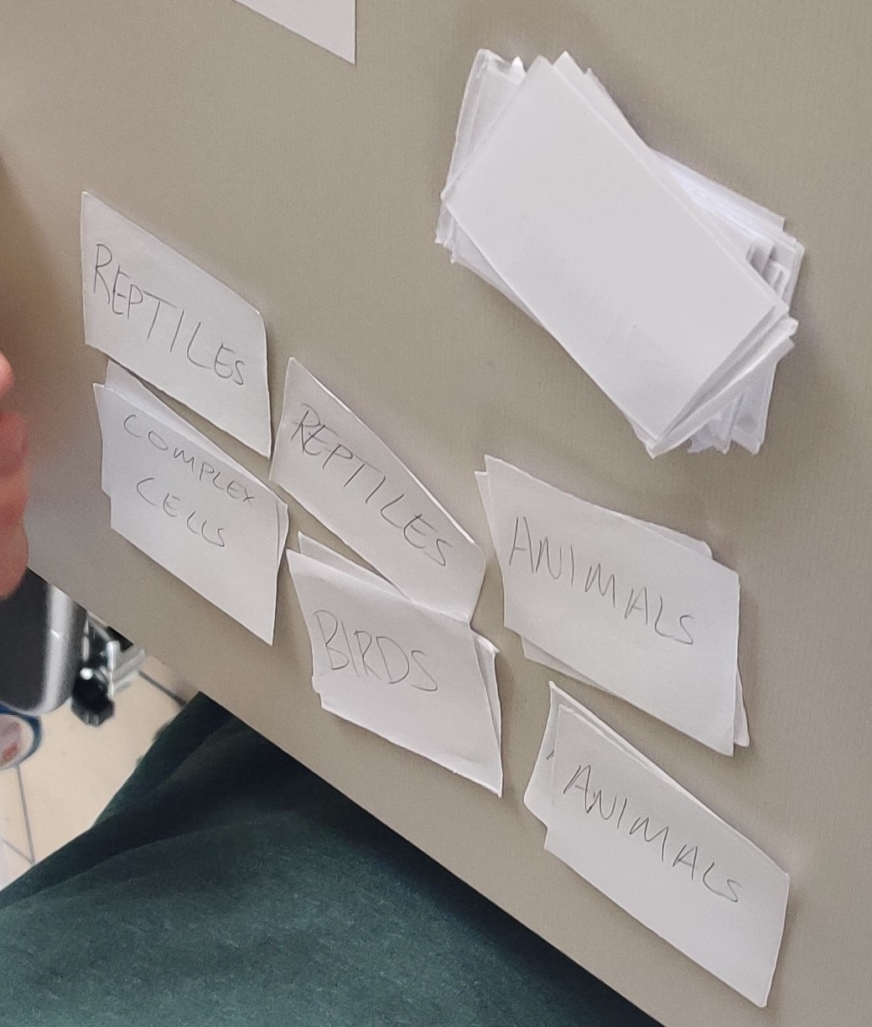
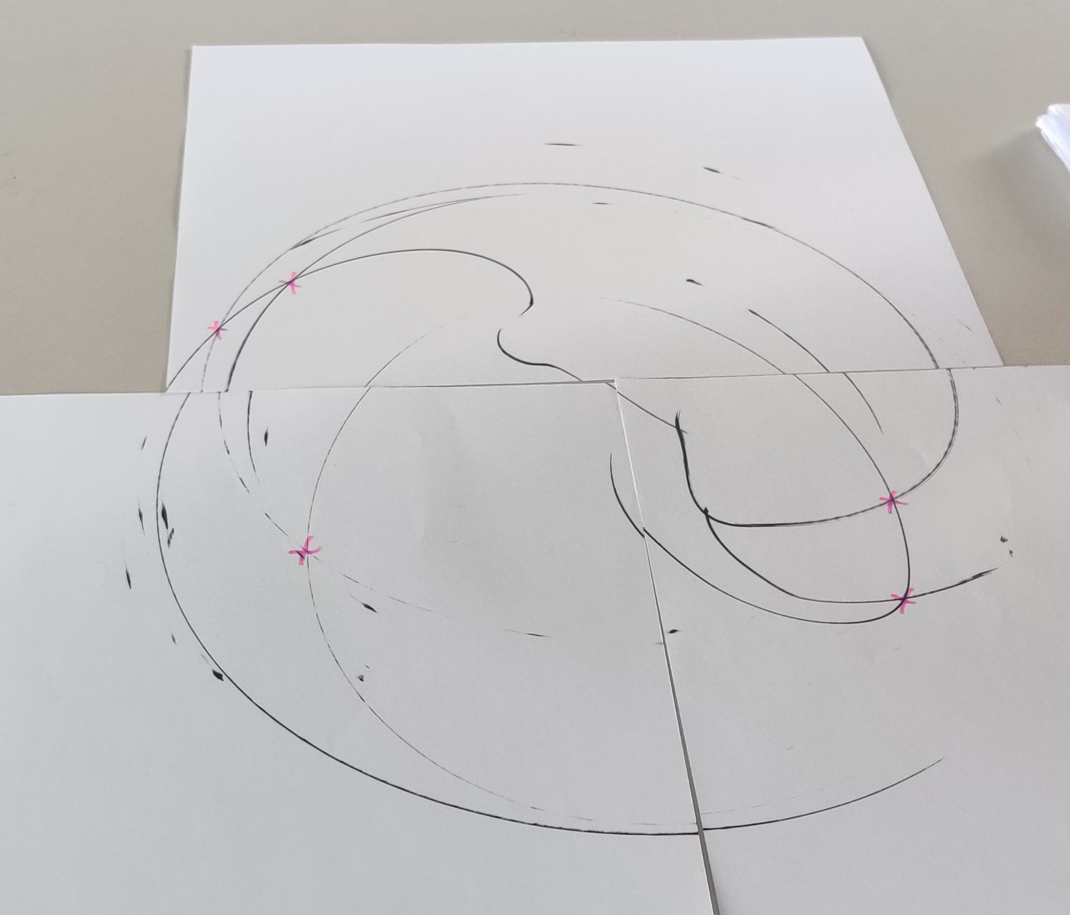
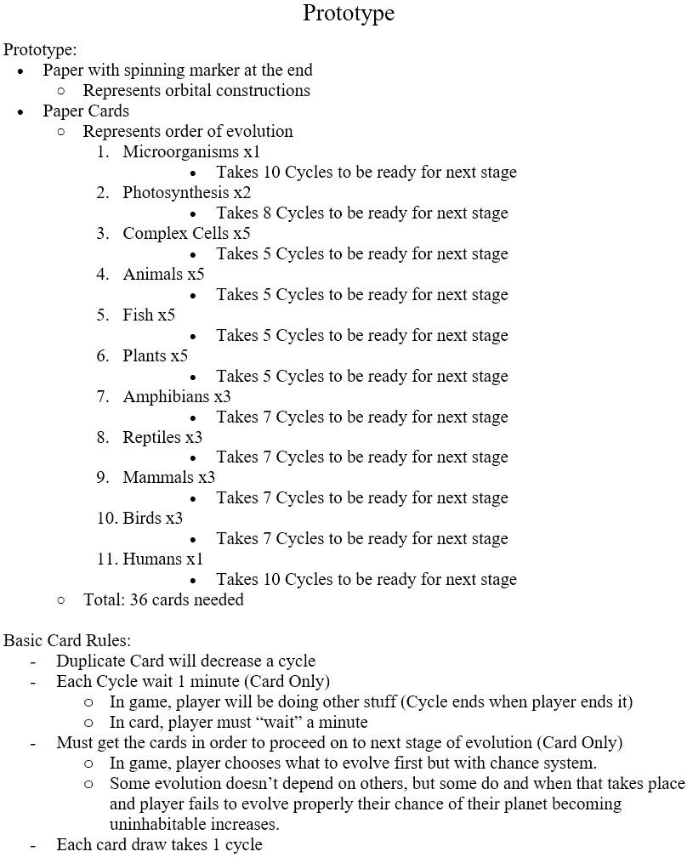
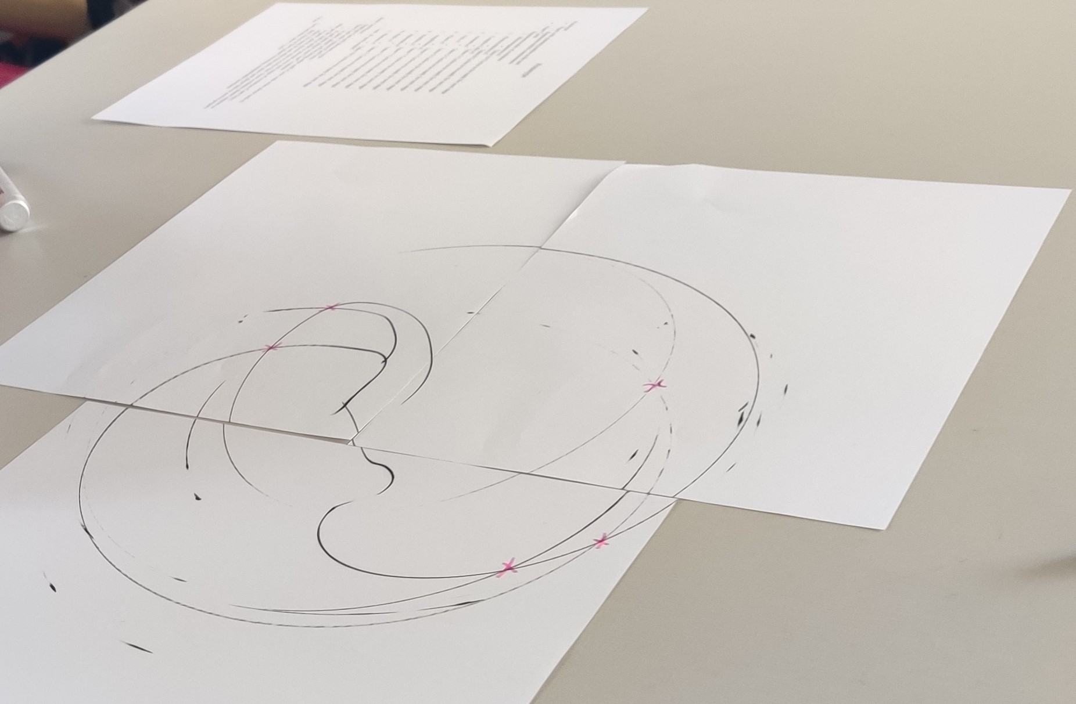
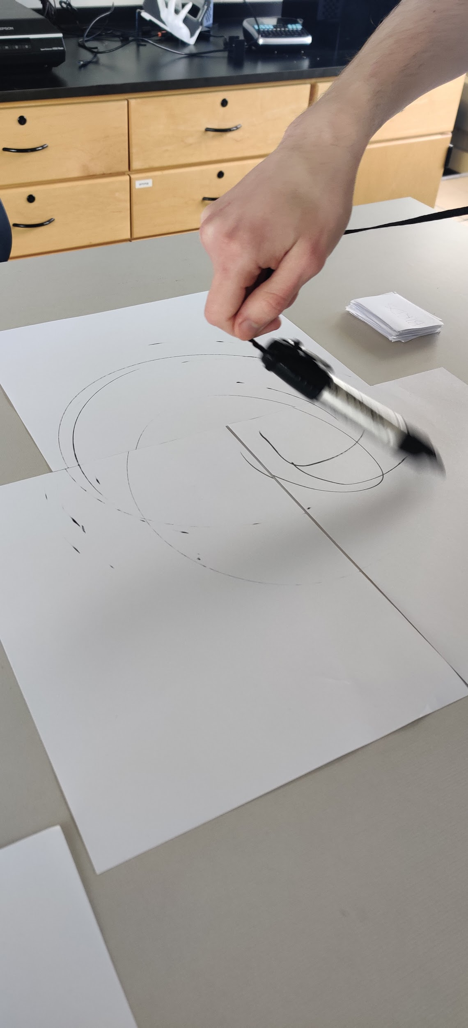
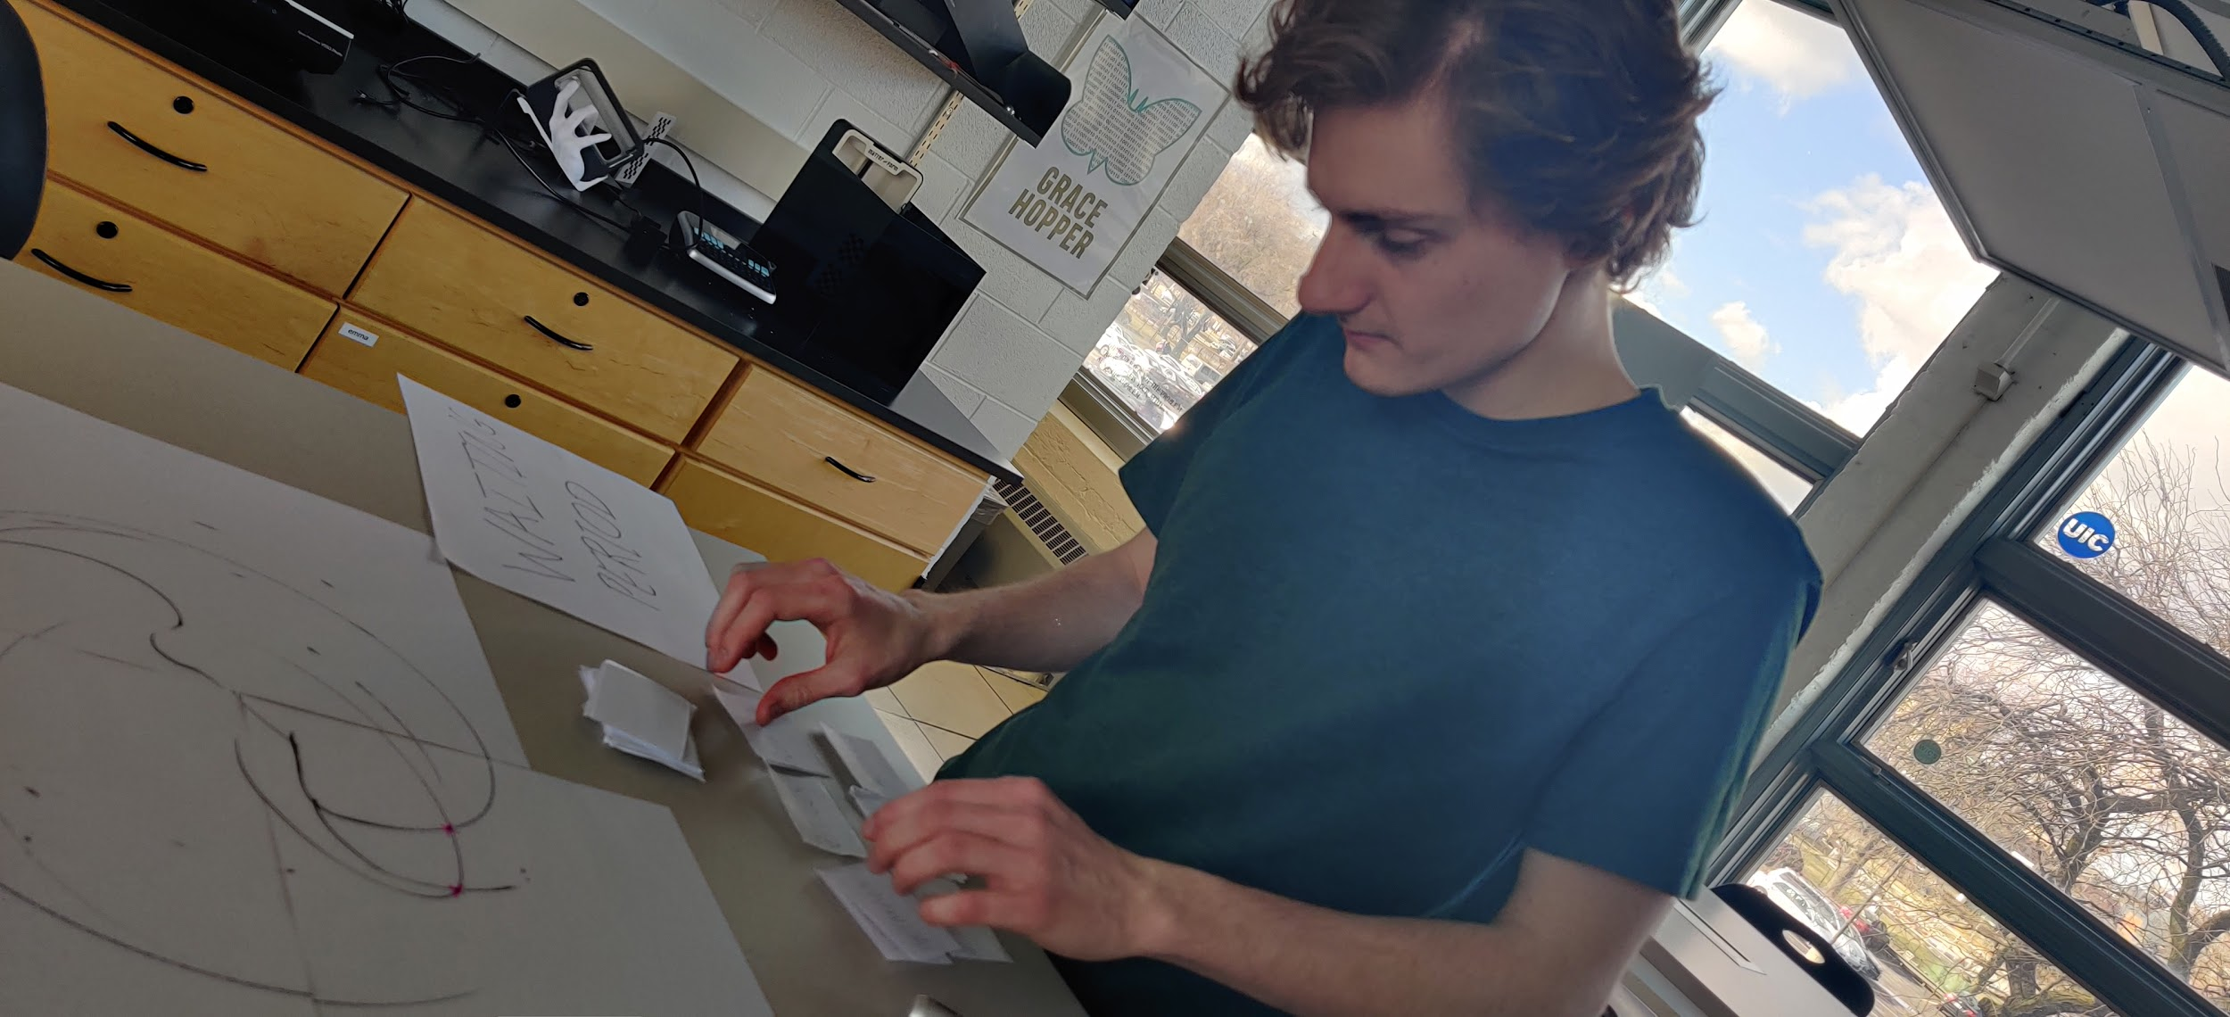
Prototype

Slide 16
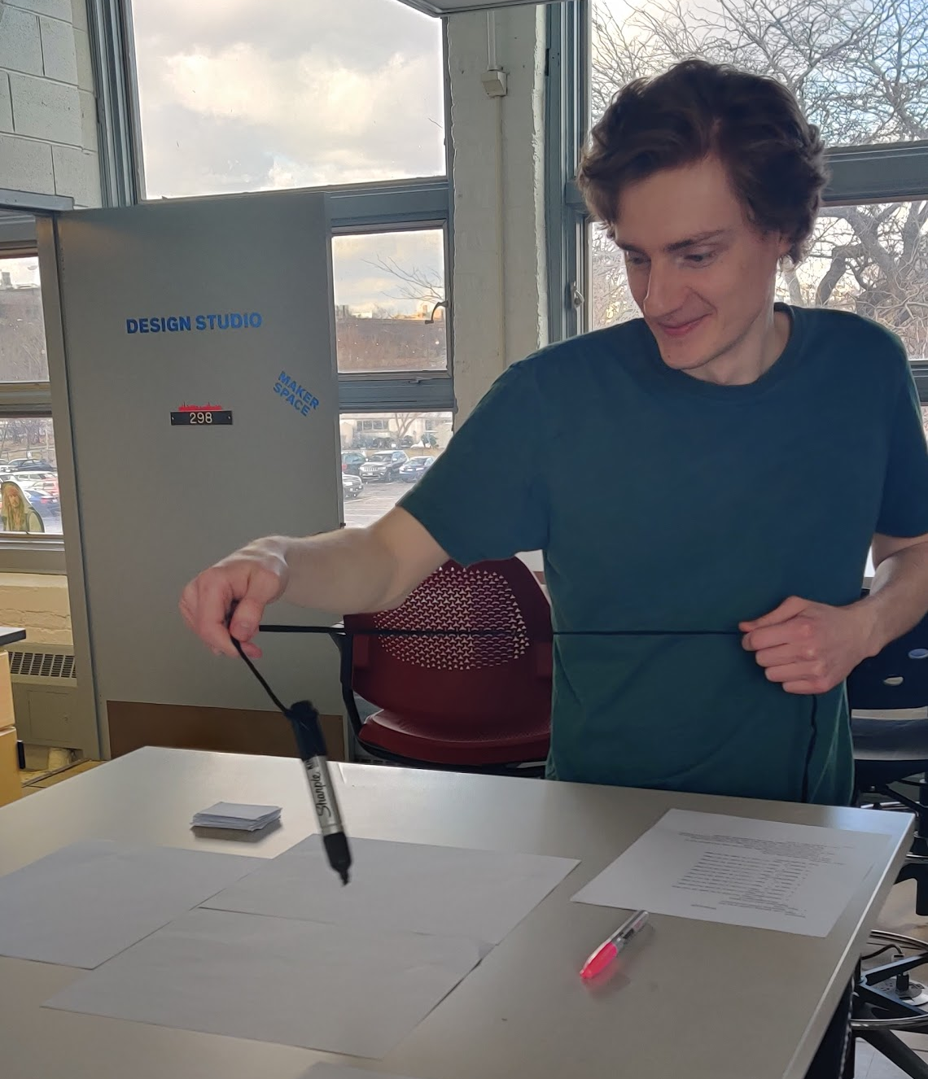
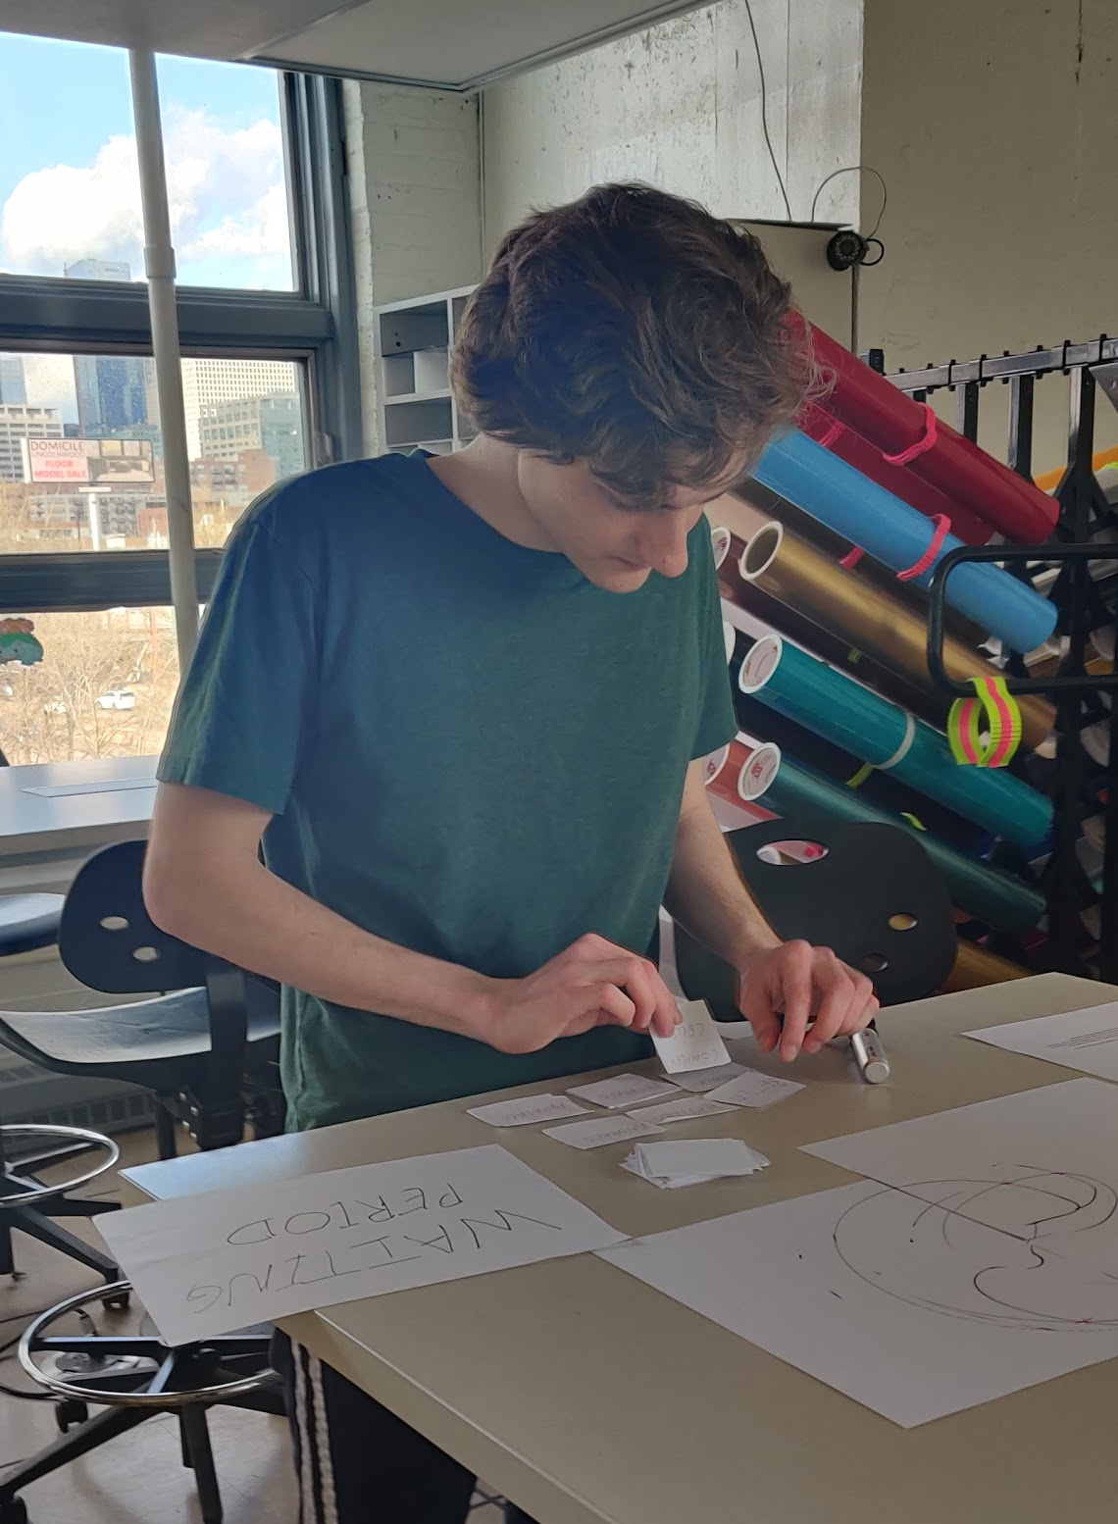
Prototype Explained
Orbital: Created by attaching sharpie to string and being spun around on top of a paper which represents the planetary system.
Evolutions: Obtained by drawing cards. Number of cards for each stage are different to simulate chance system.

Slide 17
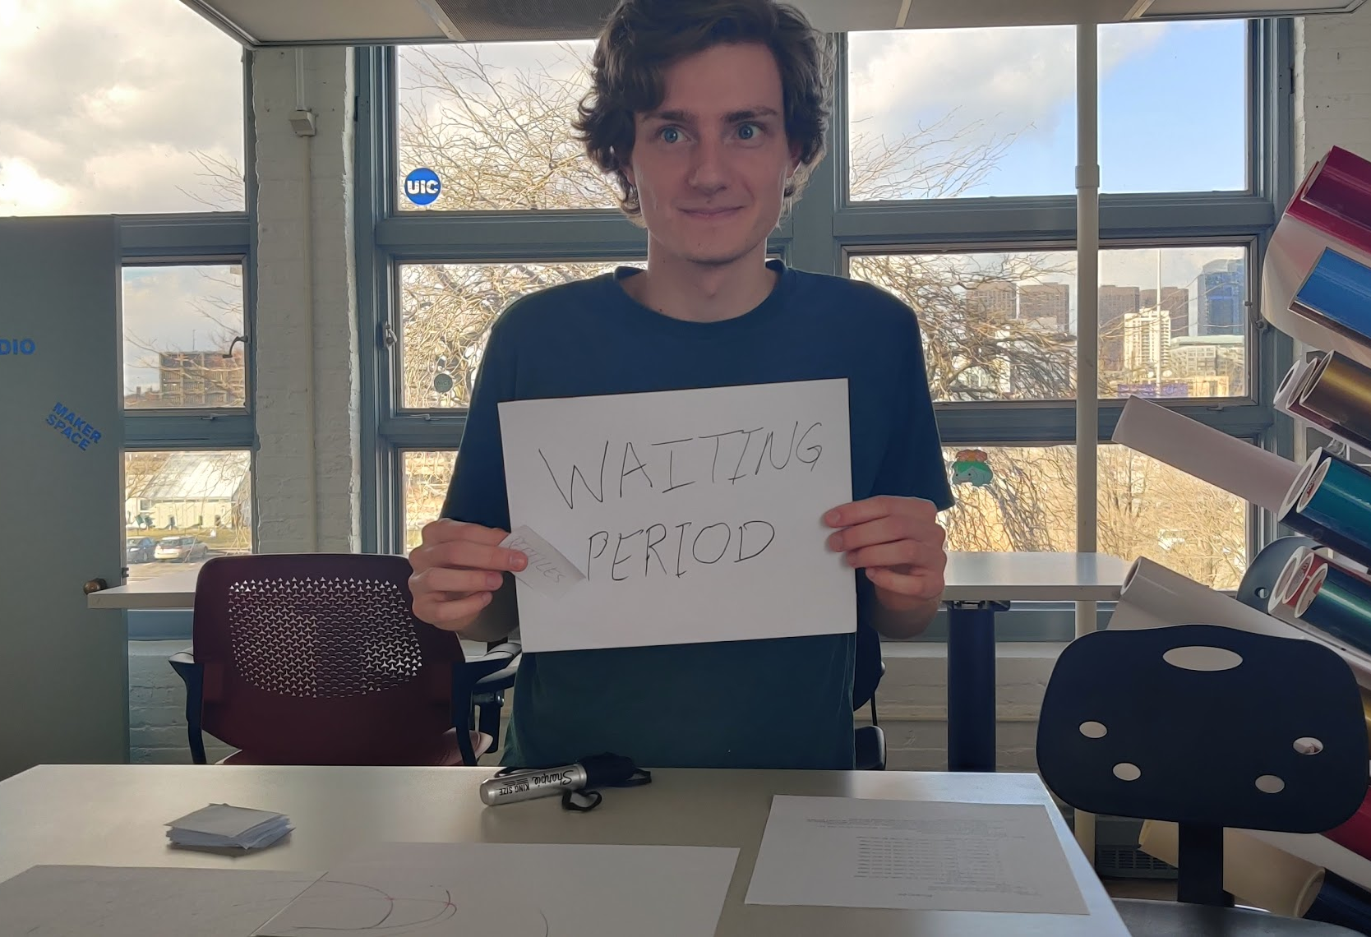

Slide 18
Conflict Simulation
After the orbitals are drawn, some will have a chance of collision with other planets who intersects with their orbits.
Pink X’s on the right shows the collision that could happen.
Even if it’s marked it doesn’t mean it will collide.

